Slide 1
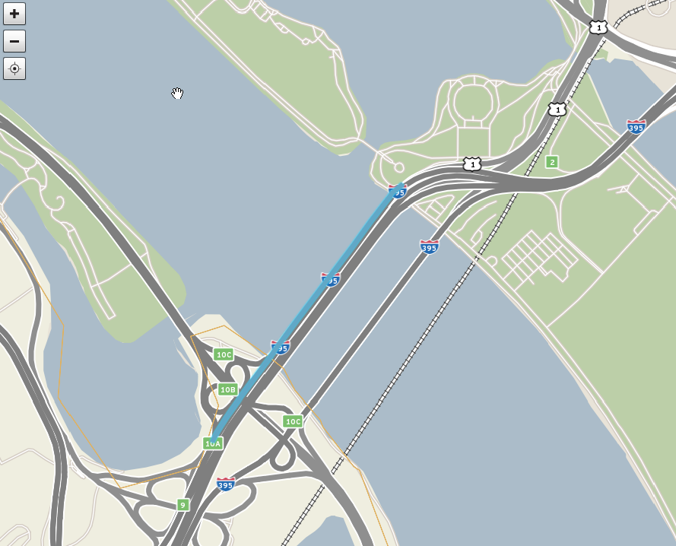
110N04131
110-04131
110N04130
110-04130

Slide 2
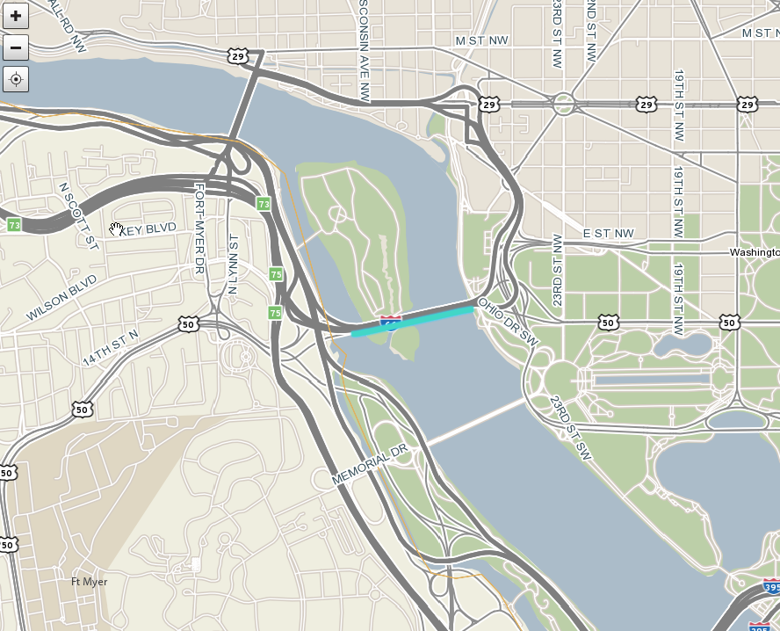
110N04161
110-04161

Slide 3
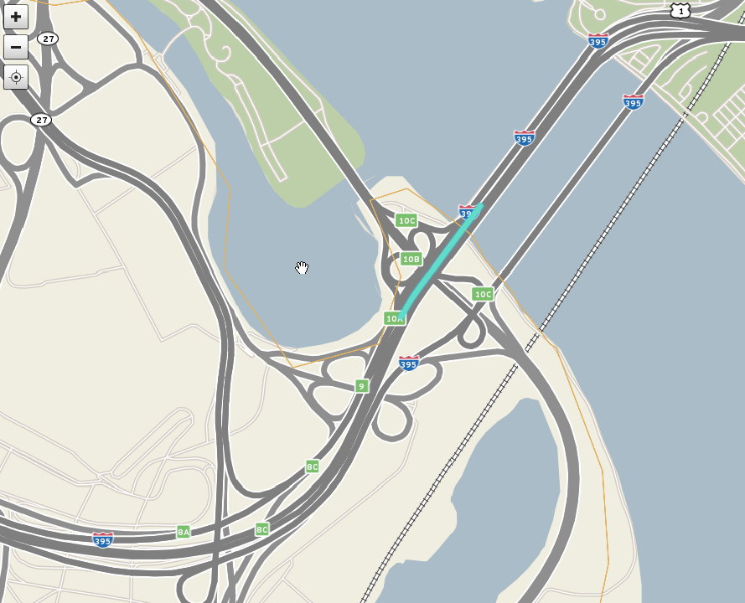
110N04302
110-04302

Slide 4
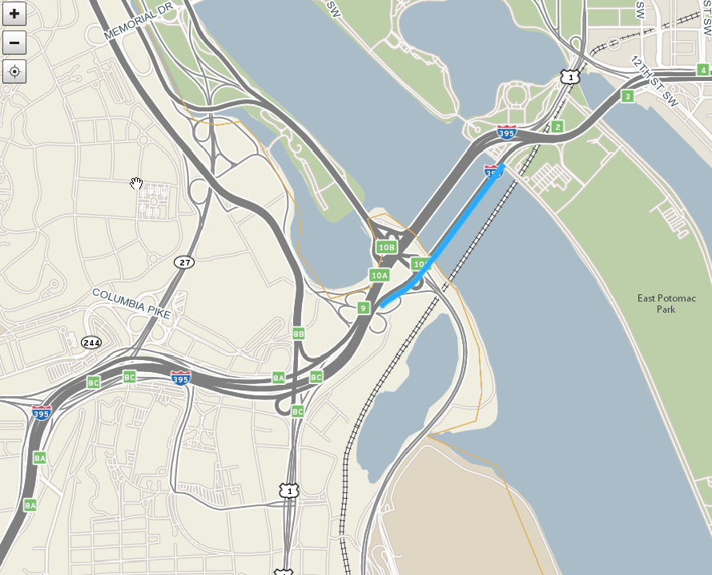
110P04131
110+04131
110P04130
110+04130

Slide 5
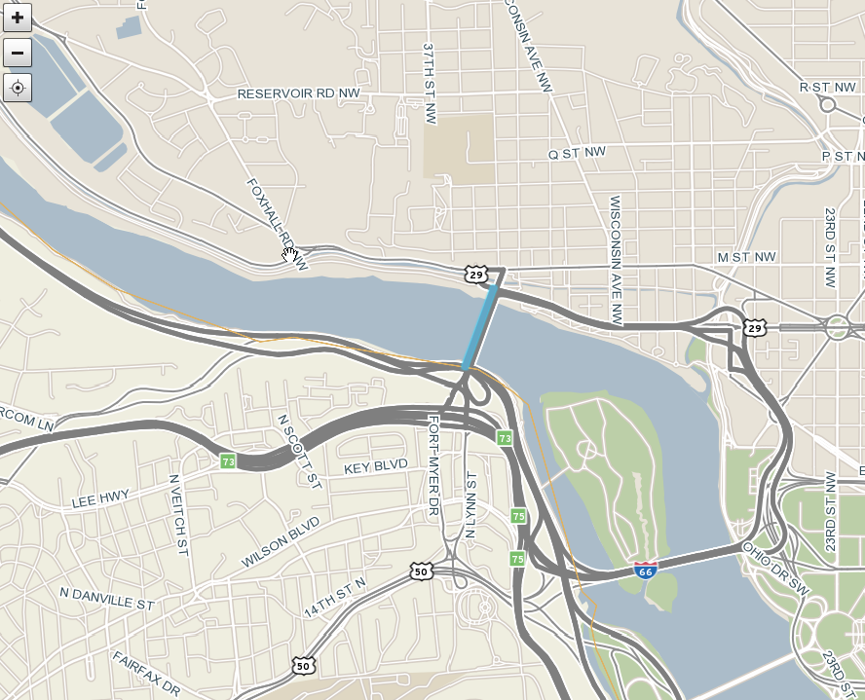
110-05754

Slide 6
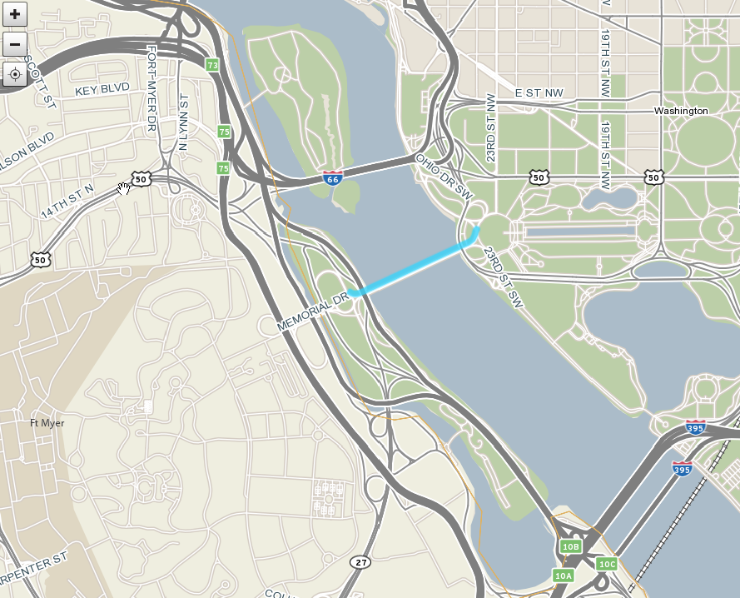
110-05756

Slide 7
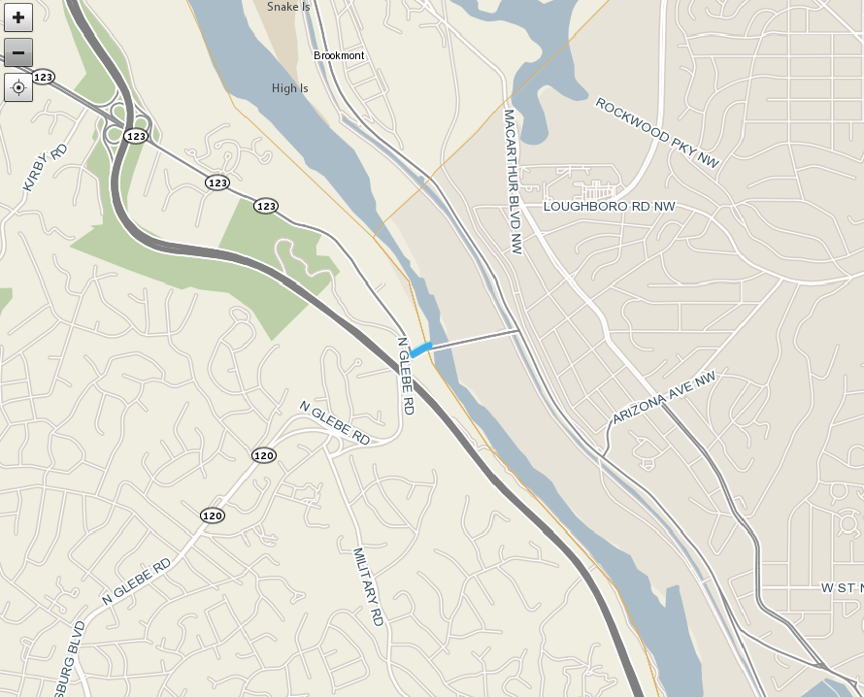
110-10237

Slide 8
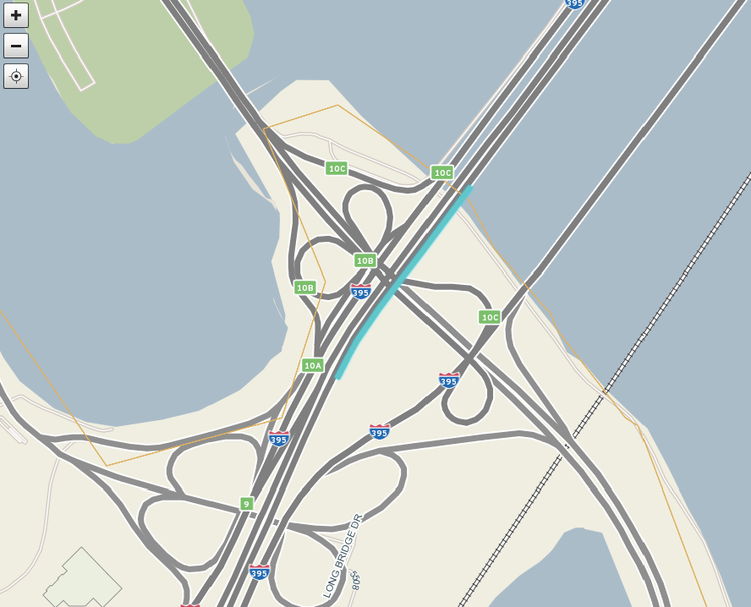
110+04303

Slide 9
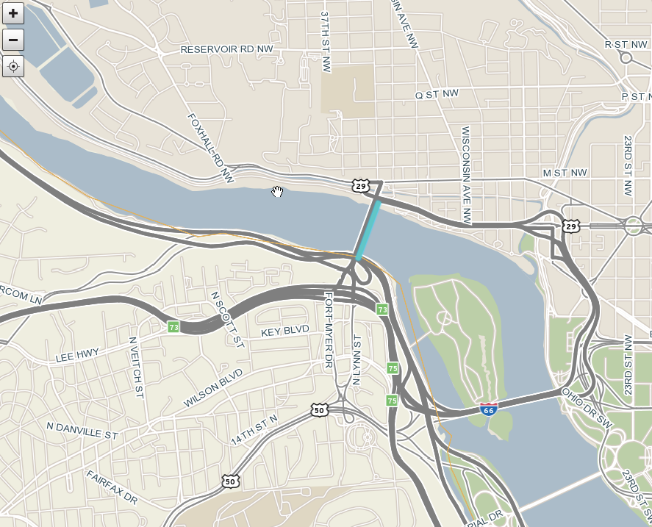
110+05755

Slide 10
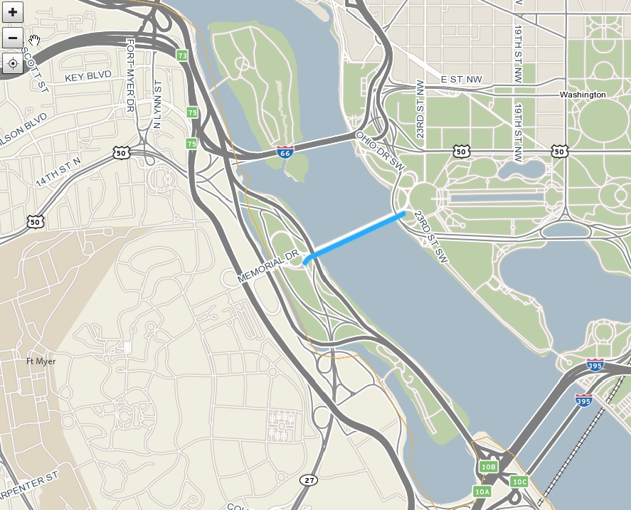
110+05757

Slide 11
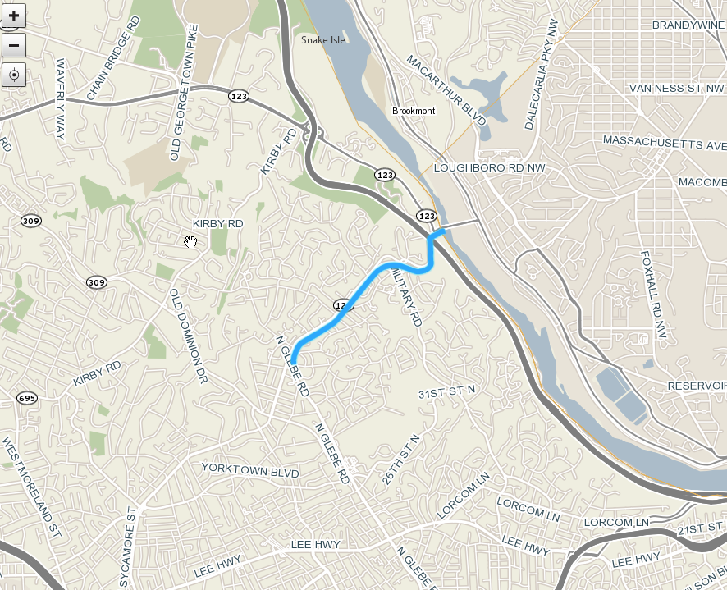
110+10237
110+10238

Slide 12
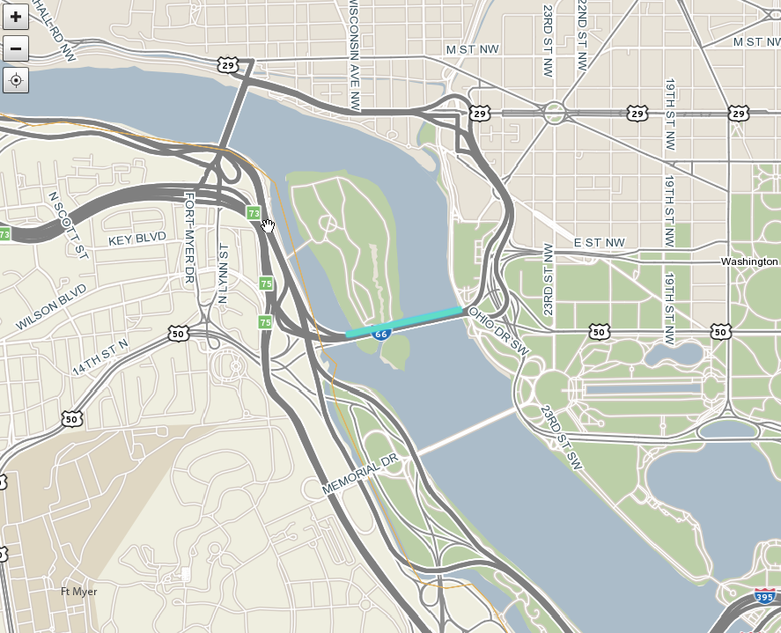
110P04161
110+04162

